Slide 1
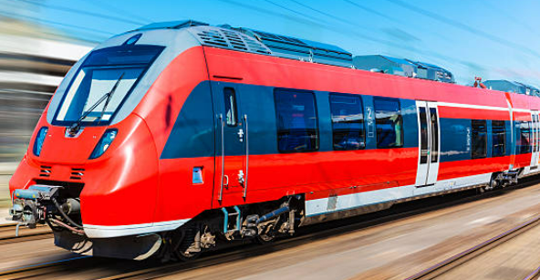
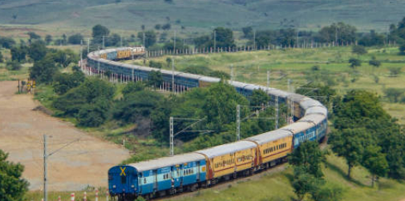
Book my Train
Home
Services
Route
More
Signup
Register
Disruptions
Signin
Booking
User Name:
Regional
Password:
Metro
Forgot password
Forgot Username
Refund
MyKi
One way trip
Top-up
Round trip
Fares
From
To
Date
Address
Customer Service
Contact us
About us
Legal and Policies

